Slide 1
Lecture 12 Minimum Spanning Trees
Zonghua Gu (based on Jianchen Shan)
Department of Computer Science
Hofstra University

Slide 2
Lecture Goals
In this lecture we study the minimum spanning tree problem.
We consider two classic algorithm for the problem—Kruskal's algorithm and Prim's algorithm.

Slide 3
Minimum Spanning Tree (MST)
Given. Undirected graph G with positive edge weights (connected).
Def. A spanning tree of G is a subgraph T that is both a tree (connected and acyclic) and spanning (includes all of the vertices).
Goal. Find a min weight spanning tree.
4
24
4
24
23
9
23
9
6
18
6
18
5
11
5
11
16
8
16
8
10
14
7
10
14
7
21
Brute force.
Try all spanning trees?
21
graph G
not connected
4
24
4
24
23
9
23
9
6
18
6
18
5
11
5
11
16
8
16
8
10
14
7
10
14
7
21
21
not acyclic
spnning tree T: cost = 50 = 4 + 6 + 8 + 5 + 11 + 9 + 7

Slide 4
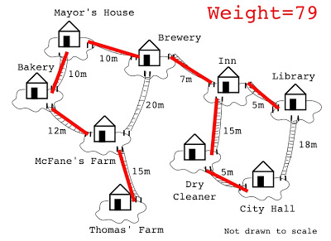
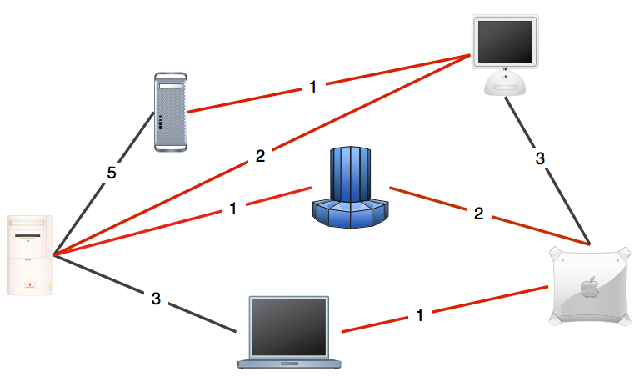
MST Applications
One example would be a telecommunications company trying to lay cable in a new neighborhood. If it is constrained to bury the cable only along certain paths (e.g. roads), then there would be a graph containing the points (e.g. houses) connected by those paths.
Some of the paths might be more expensive, because they are longer, or require the cable to be buried deeper; these paths would be represented by edges with larger weights.
A MST would be one with the lowest total cost, representing the least expensive path for laying the cable.
Network design.
Cluster analysis.
Indirect applications.

Slide 5
Kruskal’s Algorithm
Consider edges in ascending order of weight.
Add next edge to tree T unless doing so would create a cycle.
graph edges sorted by weight
does not create a cycle
creates a cycle
0 - 7 | 1
2 - 3 | 2
1 - 7 | 3
0 - 2 | 4
5 - 7 | 5
1 - 3 | 6
1 - 5 | 7
2 - 7 | 8
4 - 5 | 9
1 - 2 | 10
4 - 7 | 11
0 - 4 | 12
2 - 6 | 13
3 - 6 | 14
0 - 6 | 15
4 - 6 | 16
1
3
5
7
2
0
4
6
an edge-weighted graph
Kruskal's algorithm in 2 minutes
https://www.youtube.com/watch?v=71UQH7Pr9kU

Slide 6
Prim’s Algorithm
Start with vertex 0 and greedily grow tree T.
Add to T the min weight edge with exactly one endpoint in T.
Repeat until V – 1 edges.
1
6
3
7
3
11
5
2
5
7
2
8
15
9
12
1
4
0
14
4
13
16
17
6
Prim's algorithm in 2 minutes
https://www.youtube.com/watch?v=cplfcGZmX7I

Slide 7
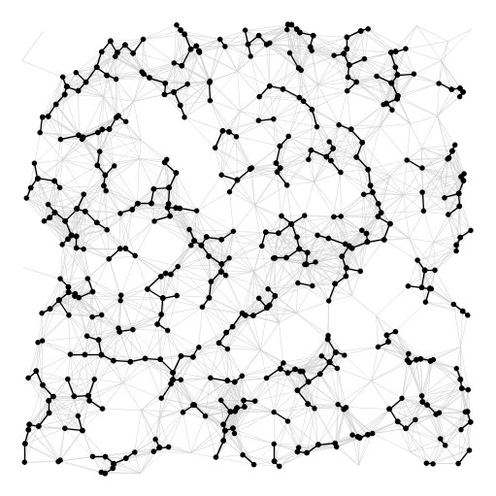
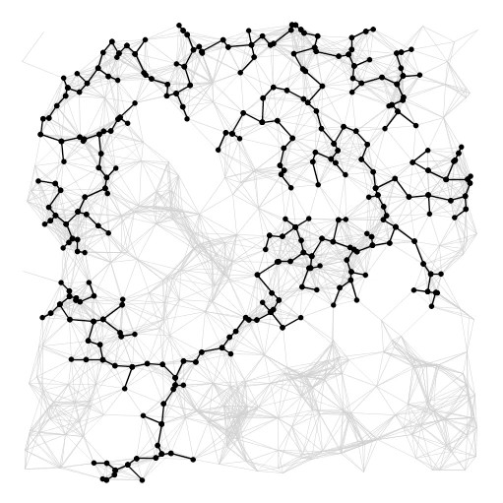
Summary
algorithm
visualization
bottleneck
running time
sorting union–find
Kruskal
E log V
Prim
priority queue
E log V
https://www.youtube.com/watch?v=vmWSnkBVvQ0

